Slide 1

BinWise: AI-Powered Recycling Innovation
Welcome to the future of waste management. BinWise is a full-stack recycling platform leveraging cutting-edge AI to transform how we sort, classify, and value recyclable materials. This presentation dives into the core of our innovation: the AI Module.

Slide 2
The Problem & Our Solution
The world faces an escalating waste crisis, with global population growth driving waste generation to over 2 billion tons annually, a figure projected to rise significantly. Current recycling processes are plagued by inefficiency; manual sorting is labor-intensive, time-consuming, and prone to errors, leading to high contamination rates and low material recovery. Furthermore, complex sorting guidelines often deter individual consumers, resulting in low participation rates. There's a critical need for accessible, intuitive, and rewarding recycling solutions that integrate seamlessly into everyday life. BinWise directly addresses these challenges with an AI-powered smart recycling system. Our innovation leverages advanced automation and real-time feedback to simplify the user experience, while gamification through rewards incentivizes higher participation. The benefits are clear: increased recycling rates, significantly reduced contamination, improved resource recovery, and a substantial positive impact on environmental sustainability.
Key Stakeholders
Environmental Organizations & NGOs
Municipal Waste Management Authorities
Waste Management & Recycling Companies
Individual Consumers & Households
Technology Partners & AI Developers
Government Agencies & Policy Makers
Educational Institutions
Corporate Partners & Brands

Slide 3
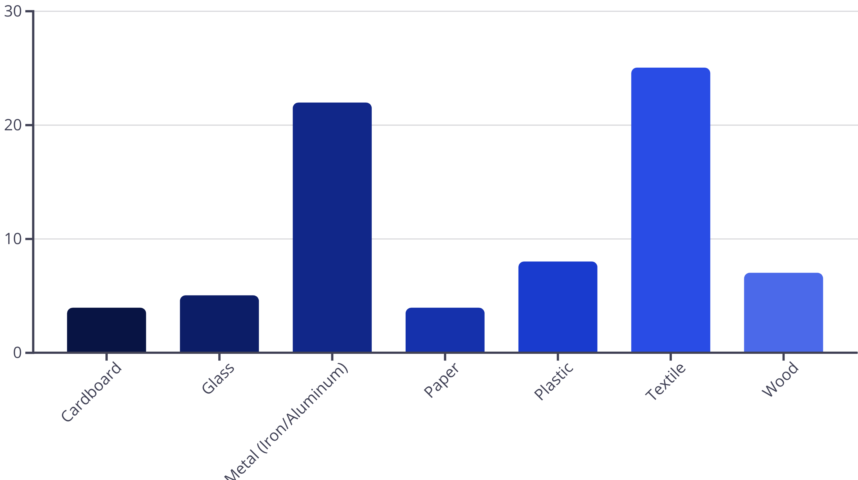
Dataset Collection & Distribution
The dataset was manually collected with 7 material categories (Plastic, Glass, Wood, Iron/Metal, Paper, Cardboard, Textile). Each category contains multiple object classes, with 80 images labeled for each object class using Label Studio for precise annotation, resulting in a comprehensive and balanced dataset.
Total: 75 object classes across 7 material categories, with 80 images per class = 6,000+ labeled images
Waste Material Value & Point System
The following table outlines the valuation and corresponding point calculation for different recyclable materials, serving as the foundation for the BinWise reward system.
Plastic
25g
0.16 €
Mean
166.66
167
25.05
Paper
8g
0.05 €
Mean
53.33
53
7.95
Carton
8g
0.05 €
Mean
53.33
53
7.95
Glass
3.5g
0.02 €
Mean
23.33
23
3.45
Clothes (Textile)
17.5g
0.11 €
Mean
116.66
117
17.55
Metals
43g
0.28 €
Median
286.66
287
43.05
This detailed breakdown ensures transparency and fair compensation for users based on the market value and weight of their recycled contributions.

Slide 4




The AI Module: Core Predictive Engine
Real-time Identification
Weight Estimation
Instantly recognize and categorize waste items.
Accurately quantify recyclable waste for reward calculation.
Reward Automation
Seamlessly integrate with a reward-based system to incentivize proper disposal.
The AI Module is the central intelligence of BinWise, processing user-uploaded images to deliver precise classification and quantification data.

Slide 5
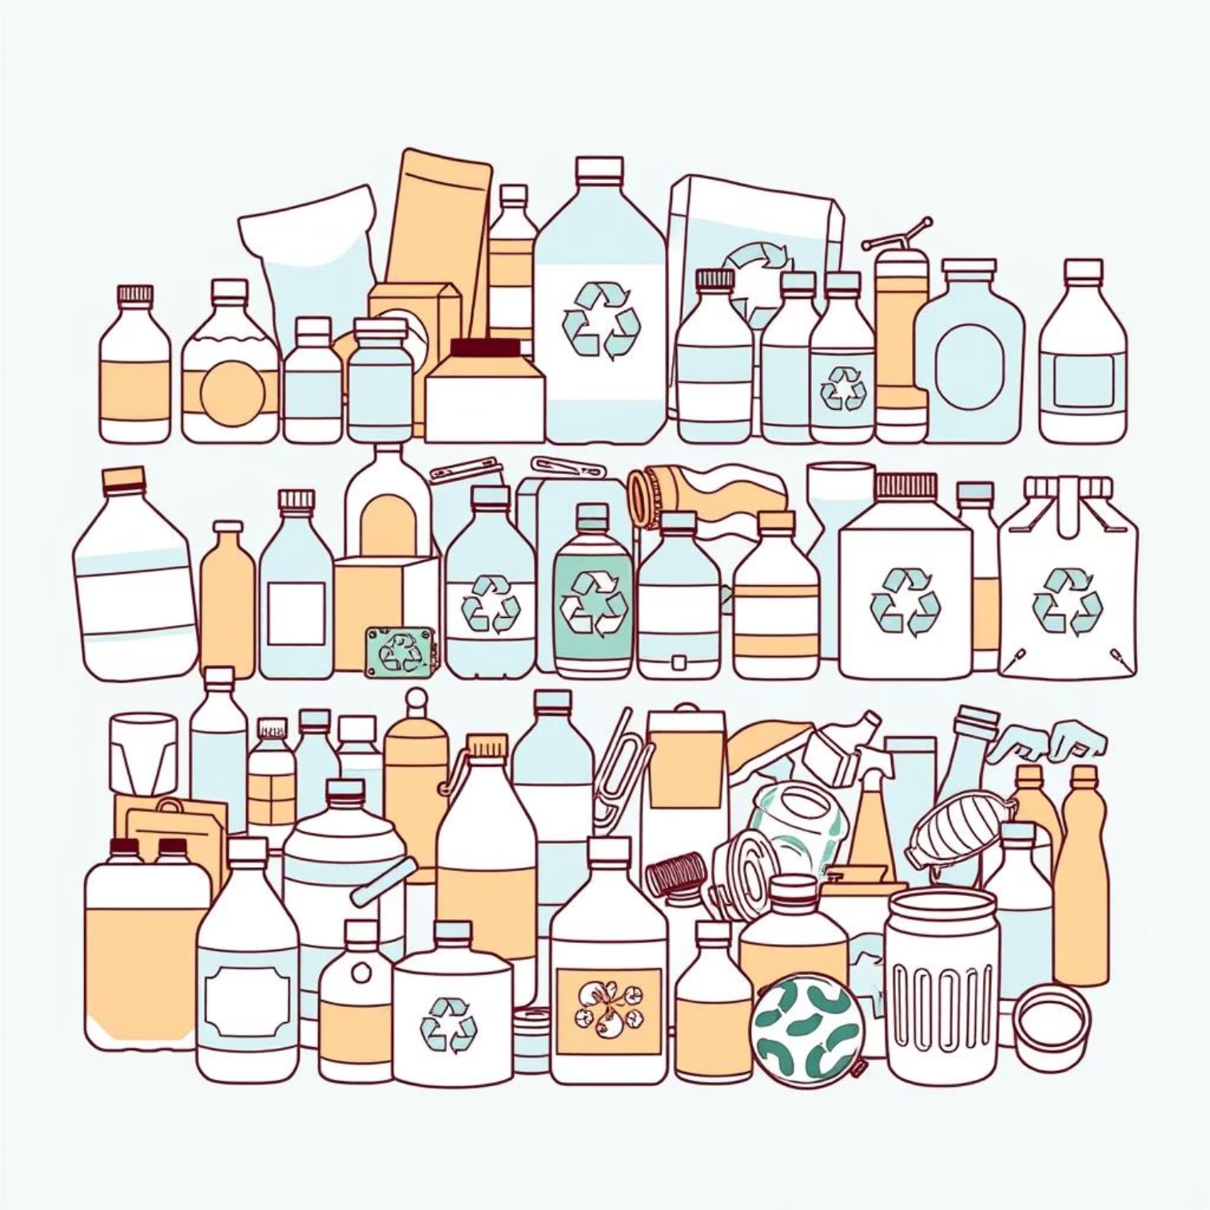
AI Module Objectives & Scope
Key Objectives
AI Team's Scope
Data Preparation: Curate a 6,000+ image dataset across 55 object classes.
Computer Vision Pipeline: Dataset creation, YOLOv8 training, object & material classification.
Model Implementation: Transition to YOLOv8 for robust multi-object detection.
Logic Development: Weight estimation and reward calculation framework.
Weight Estimation: Develop a deterministic system via lookup tables.
Deployment & API: Setup FastAPI, Docker, HuggingFace, and API schema design.
API Design & Deployment: Deploy a low-latency FastAPI service on HuggingFace Spaces.
Performance: Achieve 70% accuracy, 0.65 precision, and <2s API response time.

Slide 6

Functional Requirements of the AI Module
Object Detection: Pinpoint and bound objects within images.
Classification: Assign precise labels from 55 categories.
Material Identification: Infer material type (e.g., Plastic, Metal) from 7 categories.
Multi-Object Handling: Process images with multiple items, returning all detections.
Weight Estimation: Calculate weight in grams using a lookup table.
Reward Calculation: Apply formula for reward points based on material and weight.
API Output: Deliver structured JSON with all prediction details.
The AI Module is engineered to perform a comprehensive set of functions, from visual detection to precise data output for backend integration.

Slide 7

Non-Functional Requirements & Use Case
Non-Functional Requirements
Waste Scanning & Classification Use Case
Performance: API response < 2 seconds for a smooth user experience.
Actor: User
Scenario: User uploads an image of waste. The FastAPI API processes it via YOLOv8 inference, returning prediction results (Label, Weight, Points) to the backend for display on the user dashboard.
Reliability: 70% minimum accuracy and robust concurrency handling.
Scalability: Docker and HuggingFace Spaces deployment for automatic load scaling.

Slide 8
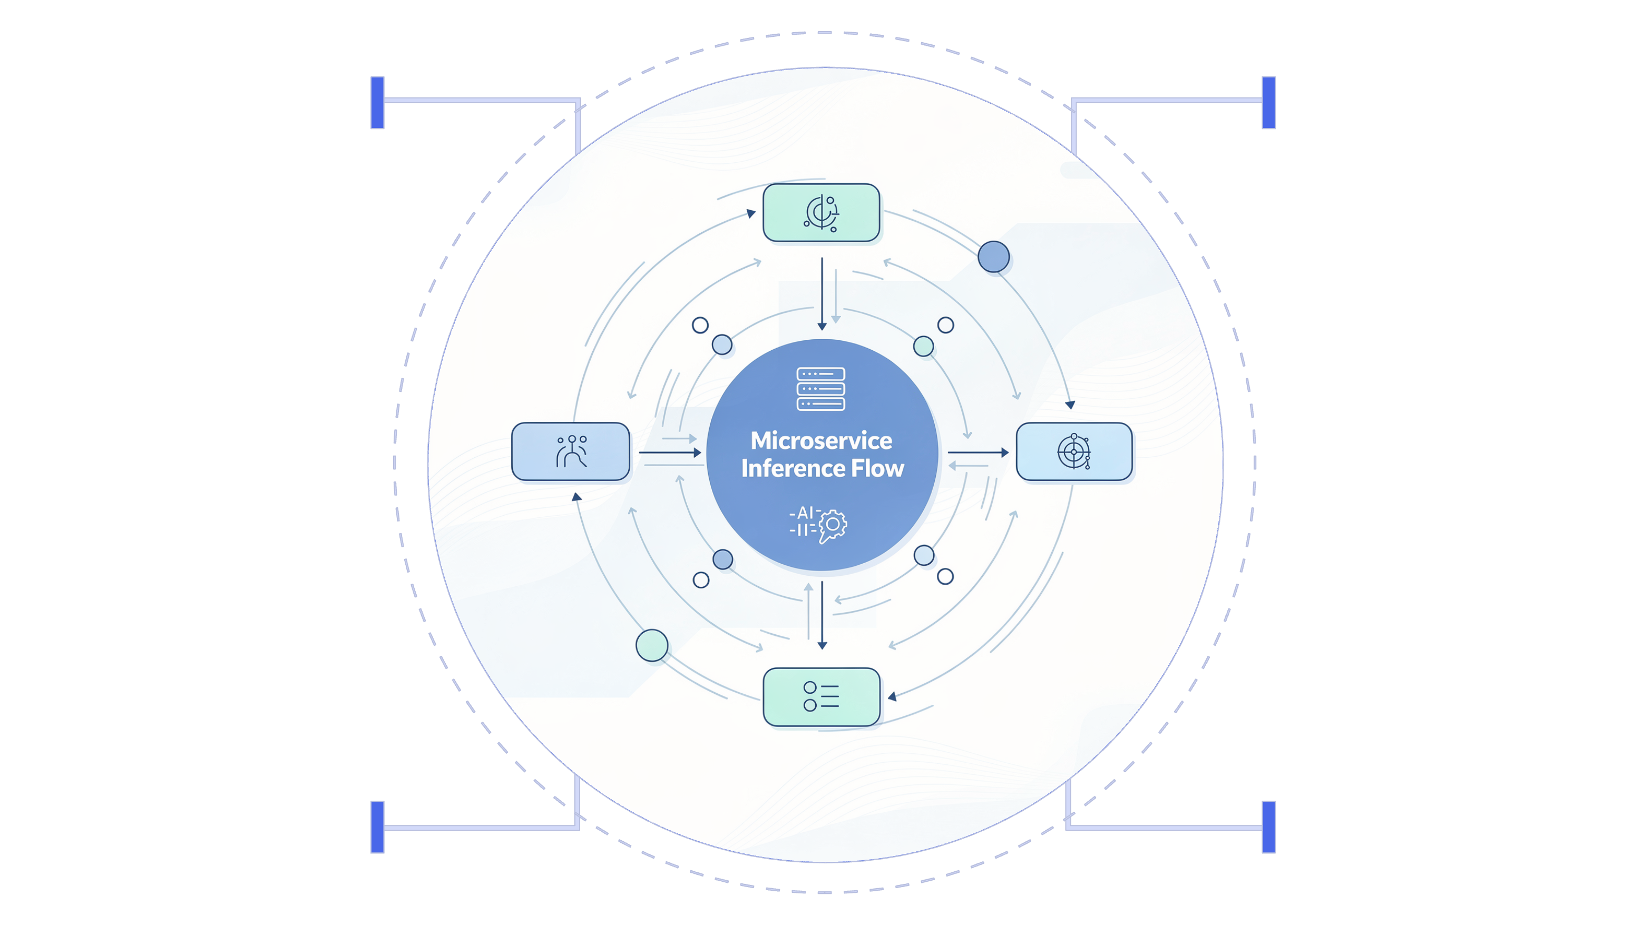
AI Module Software Architecture
Backend (Client)
FastAPI Server
Sends image bytes via REST
Receives POST, exposes REST endpoints
Weight Estimation Logic
YOLOv8 Engine
Runs inference on image bytes
Computes weight from detections
The AI Module operates as a microservice, decoupling compute-intensive computer vision tasks from the main backend. This ensures robust performance and scalability.

Slide 9

Deployment & Monitoring
Version Control & Deployment
System Monitoring & Maintenance
Version Control: GitHub repository with Feature Branching Strategy for stable code management.
Health Checks: API root endpoint provides real-time model status.
KPI Monitoring: Track response time and error rates; alerts for deviations.
Containerization: Dockerfile builds production-ready images for FastAPI/Uvicorn.
Model Performance Drift: Monitor confidence scores to signal retraining needs.
Deployment Platform: Automated deployment on HuggingFace Spaces for live service.
Maintenance: Regular software updates and scheduled model retraining based on drift or new waste types.

Slide 10
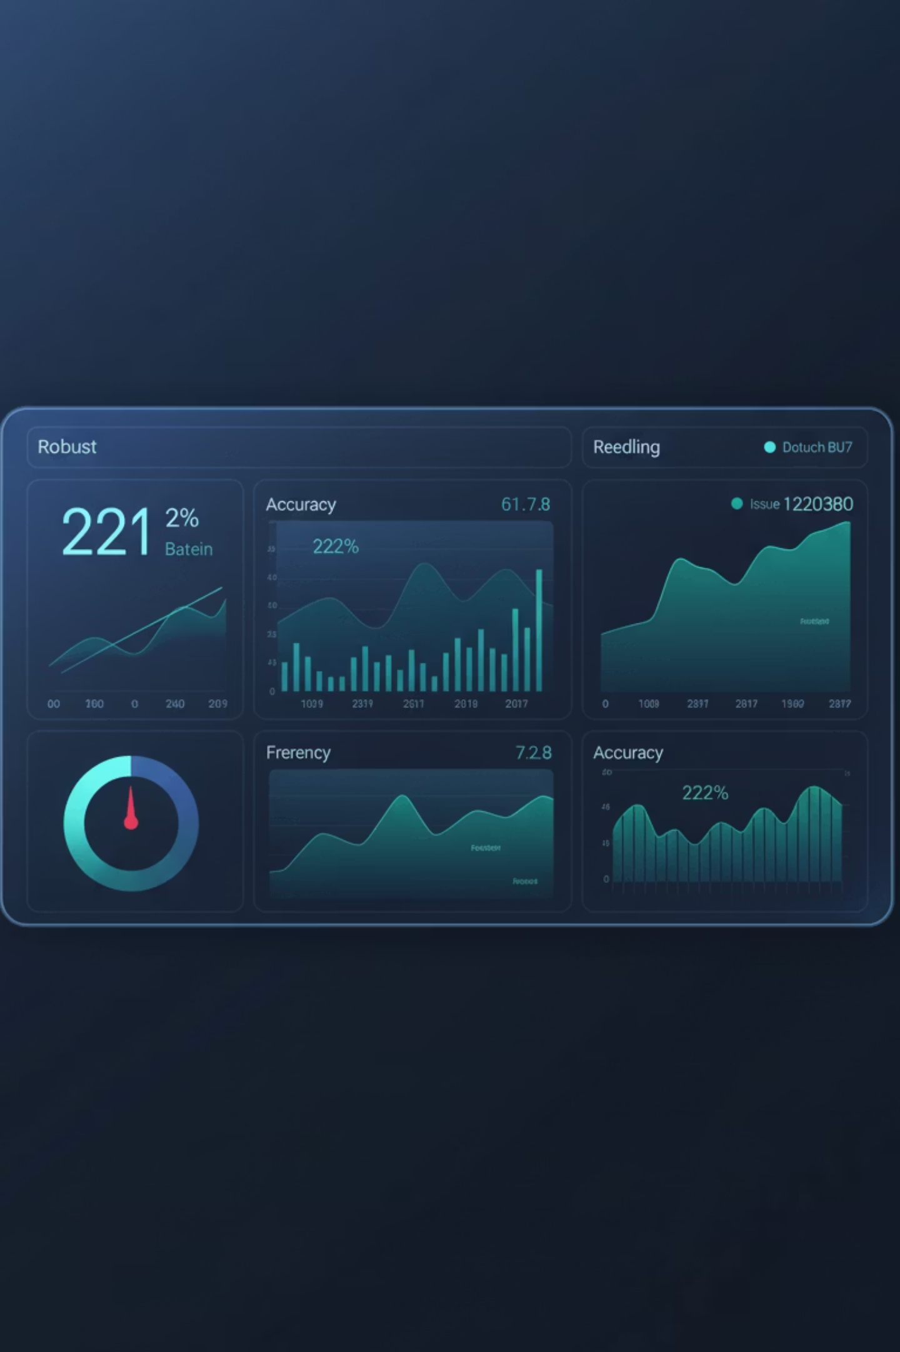
Key Performance Indicators for AI Success
70%
< 2s
< 6s
Model Accuracy
API Response Time
Model Load Time
Achieved target accuracy for reliable waste classification.
Ensured low-latency inference for a seamless user experience.
Guaranteed quick startup for API readiness.
0.5
Detection Confidence
Implemented a threshold to filter unreliable predictions.
These KPIs ensure the AI module is not only functional but performs efficiently and reliably under real-world conditions.

Slide 11
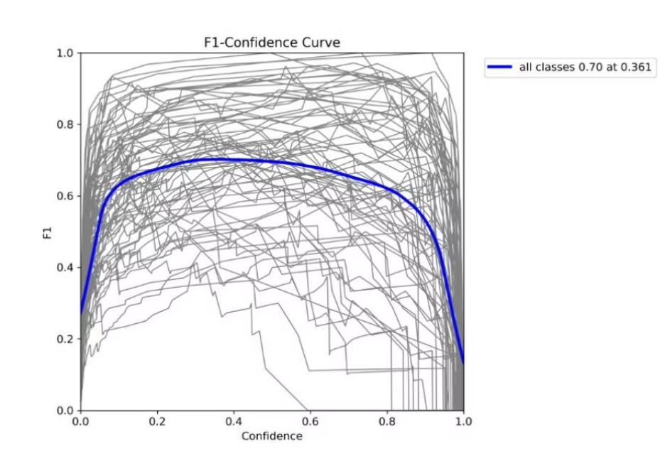
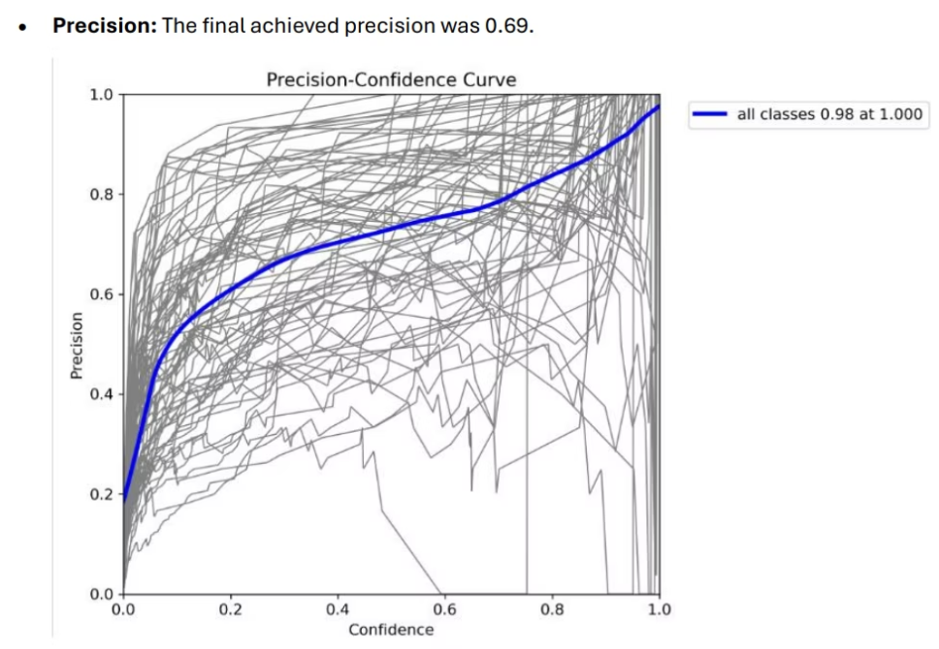
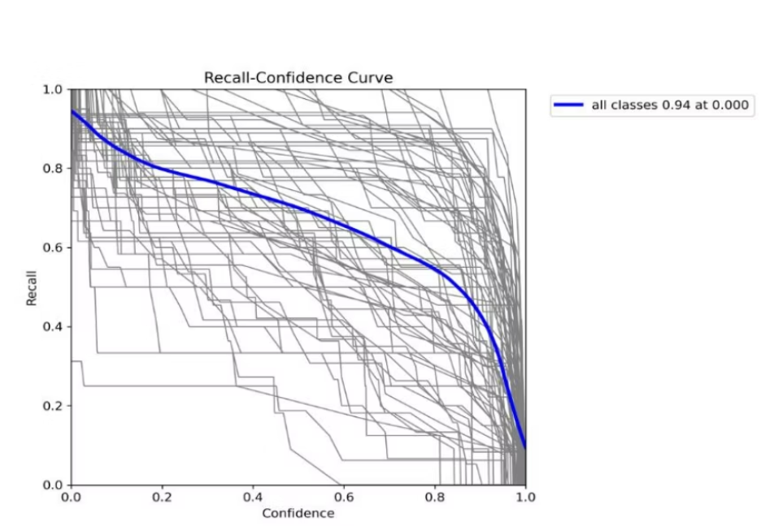
Model Performance Evaluation Metrics
F1 score of 0.70 achieved at confidence threshold 0.361. Shows optimal balance between precision and recall across all 55 object classes.
Final precision of 0.69, reaching 0.98 at maximum confidence. Higher thresholds ensure more reliable predictions but may miss some detections.
Recall of 0.94 at zero confidence threshold, detecting 94% of actual objects. Recall decreases as confidence increases, reflecting the detection trade-off.

Slide 12





Challenges
Imbalanced Dataset
Mitigated with data augmentation (oversampling, class weighting) to ensure model fairness across 55 object classes.
Long Training Duration
Optimized pipelines and leveraged Google Colab for cloud GPU access, reducing 14-hour training times.
Hardware Limitations
Accepted lower batch sizes; prepared to switch to lighter YOLO models (e.g., YOLOv8n) if resource constraints escalated.
Multi-Object Failure
Replaced MobileNetV2 with YOLOv8 for native multi-object detection and accurate bounding box returns.

Slide 13
Project Planning Phase Duration (Weeks)
Phase
Duration (Weeks)
Key Activities
Status
Data Acquisition & Preprocessing
1–3 weeks
Manual collection of 6,000 images; Annotation using Label Studio; Data augmentation strategy; Initial dataset split (Train/Validation/Test)
Complete
Model Selection & Training Setup
4–6 weeks
Finalize transition from MobileNetV2 to YOLOv8; Define the 55 object classes and 7 material categories; Set up training environment (Google Colab/Cloud GPU); Establish baseline hyperparameters
Complete
Core Model Training & Optimization
7–9 weeks
Execute YOLOv8 training for 50 epochs (14 hours); Apply mitigation strategies (oversampling, class weighting); Hyperparameter tuning; Final model selection based on 70% Accuracy
Complete
Weight Logic & API Development
10–11 weeks
Integrate deterministic Weight Estimation Lookup Tables; Design the Reward Calculation Framework; Develop the FastAPI inference service (/detect/ endpoint); Implement lifespan model loading logic
Complete
Containerization & Deployment
12–13 weeks
Create Docker container image (FastAPI, Python environment, YOLOv8 model); Test container locally; Deploy the service to HuggingFace Spaces; Test the live API response time (Target < 2 seconds)
Complete
Testing & Quality Assurance
14–15 weeks
Execute comprehensive Test Cases (Classification, Multi-object, Weight Consistency, Confidence Threshold); Final validation of KPIs (Precision 0.65, Recall 0.70); Conduct final integration tests with the Backend team's JSON parsing logic
Complete
Documentation & Finalization
16 weeks
Finalize academic documentation; Prepare Project Presentation; Submit all code, models, and documentation to the Version Control Repository (GitHub)
Complete

Slide 14

Technical Documentation & Deliverables
Source Code Repository
API Documentation
Deployment Link
Full GitHub link for transparency and collaborative development.
Comprehensive guide for the /detect/ endpoint, detailing request/response schemas.
Direct access to the live, executable service on HuggingFace Spaces.
These deliverables ensure our AI Module is well-documented, accessible, and ready for integration and future enhancements.

